Slide 1
Life Cycle
Notes:
Welcome back to this introductory course on data for data science.
I’m Matthew Renze, data science consultant, author, and public speaker.
In this module, we’ll learn about the life cycle of data …
… the journey of data as we move from data collection to action.

Slide 2
How do we get from data to action?
Notes:
How do we get from data collection to action in data science?
What does the journey of data look through these various stages?
And what are the tools and methods involved in this process?

Slide 3





Overview
Collection
Storage
Processing
Analysis
Action
Repeat
Notes:
To answer these questions, we’re going to follow the journey of data from data collection to action.
[1] First, we’ll learn about data collection and how we record observations of our world.
[2] Next, we’ll learn about data storage, and the various types of data repositories we encounter.
[3] Then, we’ll learn about data processing, and steps we perform to prepare our data for analysis.
[4] Next, we’ll learn about data analysis, and the many tools we can use to analyze data.
[5] Then, we’ll learn about taking action based on the results of our analysis.
[6] Finally, we’ll learn about how we repeat this process, using feedback as our guide, to optimize over time.

Slide 4
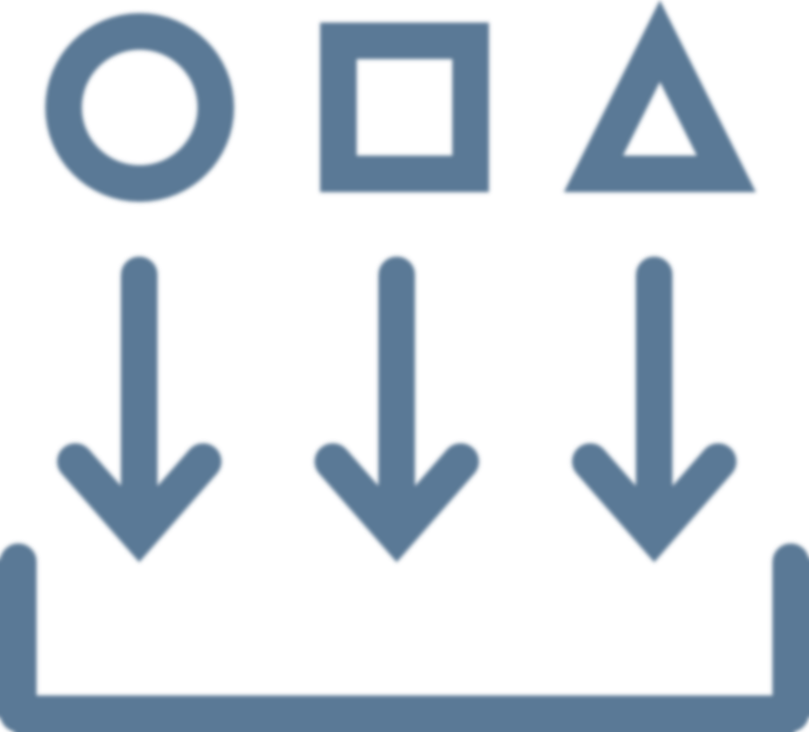
Collection
Notes:
The first step in the data lifecycle is data collection.

Slide 5
Collection
Observe phenomenon
Record observation
Both are required
Notes:
We collect data about our world in a two-step process:
[1] First, we observe a phenomenon that exists in the natural world.
This includes sensing the various qualities of the things we’re observing and measuring their quantities as well.
[2] Next, we record this observation using a symbolic representation.
In data science, this typically involves encoding the observation in a computer as a binary representation.
[3] It’s important to note that data do not exist until there has been both an observation and a recording of the observation.
Data are created as the result of something being observed and recorded as a signal or set of symbols.
Prior to a recording of an observation, there is no data, just the phenomenon that exists in the world.

Slide 6




Collection
Sensors
Transactions
Interactions
Experiments
Notes:
There are several ways we can observe our world to collect data:
[1] We can use sensors to record measurements of observable phenomena.
For example, we can record observations of the ambient air temperature using a digital thermometer.
[2] We can enter data into a transactional system, to record business transactions.
For example, we can create records for new customers, record sales transactions, and create medical records.
[3] We can also record human interactions with computer systems.
For example, we can record website visits, advertisement clicks, and time spent browsing a webpage.
[4] And we can run experiments in order to generate new data in controlled environments.
For example, we can run clinical studies to determine the effectiveness of certain medications.
High quality data begins with data collection, so it’s important to know how to properly observe and record data.

Slide 7

Storage
Notes:
The second step in the data lifecycle is data storage.

Slide 8
Storage
Volatile storage
Persistent storage
Retrieve as needed
Notes:
Once we’ve collected and recorded an observation as data, we need to store it so that it can be retrieved for future analysis.
[1] As data are being recorded by sensors, these data are first recorded temporarily in a type of memory called volatile storage.
Volatile storage means that the data are lost when the device loses power.
As a result, we need to transfer our data somewhere more permanent, so that they will be available anytime we need them.
In data science, we store our data in one of several persistent-storage mediums.
[2] Persistent storage, means that the device retains the data after the power to the device has been shut off.
For example, a computer’s hard drive retains its data even if you turn the power off and then turn it back on again.
[3] By storing our data in a persistent storage medium, we can retrieve our data as needed.
Unless we overwrite the data, or the device permanently fails, our data should always remain available.

Slide 9



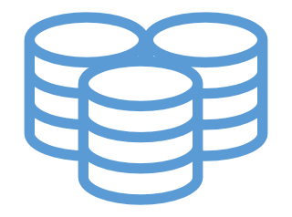
Storage
CSV
XML
File-based formats
Web-based formats
Transactional databases
Analytical databases
Big Data platforms
Notes:
Data can be stored in computers in several ways:
[1] First, we have file-based formats – which store data in files on the filesystem of a computer.
For example, comma-separate values (or CSV) files and Excel spreadsheets.
[2] Next, we have web-based formats – which store data in formats best suited for data transfer over the internet.
For example, eXtensible markup language (or XML) and javascript-object notation (or JSON)
[3] Third, we have transactional databases – which store data in a form best suited for transaction processing.
For example, normalized relational databases and No-SQL databases.
[4] Forth, we have analytical databases – which store data in a format best suited for analytical processing.
For example, data warehouses, data marts, and data cubes.
[5] And finally, we have Big Data platforms – which can store massive data sets by distributing both data and processing across many computers
For example, Spark, Hive, and Hadoop.
There are many options to choose from, so it’s important to know which option is right for your specific data-storage scenario.

Slide 10

Processing
Notes:
The third step in the data lifecycle is data processing.

Slide 11
Processing
Transform
Clean
Query
Notes:
Once we’ve stored our data, we need to process them in order to prepare them for analysis.
This involves several steps:
[1] First, we may need to transform the data.
For example, we need to reshape tables, rename columns, convert data types, and encode or decode values.
[2] Next, we may need to clean the data.
For example, we need to ensure internal data consistency, deal with missing values, and handle errors and anomalies.
[3] Finally, may we need to query the data to extract just the subset of data we need for our analysis
For example, we need to select, filter, sort, group, and aggregate data from the persistent data store.
Essentially, we need to prepare our data so that our analysis will produce reliable results.

Slide 12


Processing
</>
Manual
Scripts
Pipeline
Notes:
We can perform these data-processing tasks one of three ways:
[1] First, we can perform these steps manually using tools like Microsoft Excel.
This option is only recommended for a quick, one-time, low-risk data analysis, that doesn’t require any automation, auditing, or reproducibility.
[2] Second, we can create scripts with programming languages like SQL, Python, or R.
Using scripts allows us to repeat the entire process automatically, iterate on the design over time, and document each step in the process.
[3] Finally, we can create an automated data-processing pipeline, also known as a “Data ETL”, which stands for Extract, Transform, and Load.
An automated pipeline provides a much more robust solution for data processing, but comes at a much higher cost to create and maintain.
Ultimately, we generally spend a lot of time and energy processing data in data science, so we want to choose the option that minimizes this effort in the long run.

Slide 13

Analysis
Notes:
The fourth step in the data lifecycle is data analysis.

Slide 14
Analysis
Support decisions
Explain observations
Discover information
Notes:
Once we’ve processed our data, we want to analyze them to create new information that we can act upon.
There can be many reasons to perform a data analysis.
For example:
[1] to provide support for or against decisions that we need to make,
[2] to explain observations and behaviors that we see occurring,
[3] and to discover new information from patterns that exist in the data.

Slide 15
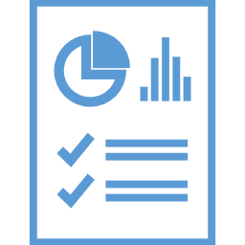




Analysis
Reports
Dashboards
Analytics
Data mining
Machine learning
Artificial intelligence
Notes:
There are numerous ways we can analyze data, for example:
[1] We can create reports, which allow us to analyze both numerical and graphical information.
[2] We can create dashboards, which present key-performance indicators (or KPIs) through a series of visual widgets.
[3] We can perform interactive data analysis, using business intelligence tools (like Excel, Power BI, and Tableau).
[4] We can perform data mining, which uses computer algorithms to find patterns of interest in large data sets.
[5] We can perform machine learning, which involves humans training computer algorithms to detect patterns in new incoming data.
[6] And we can automate data analysis with data-driven artificial intelligence, which involves machines teaching themselves how to solve problems on their own.
There are many ways that we can analyze data, so it’s important that we choose the right tool for each type of data analysis we perform.

Slide 16

Action
Notes:
The next step in the data lifecycle is action.

Slide 17
Action
Decision
Action
Outcome
Notes:
Knowledge for the sake of knowledge is a noble pursuit and valuable in it’s own right.
However, in order for data to be valuable to our business, it must lead to some form of action.
So, in data science we use the results of our data analysis to take an action of some kind.
[1] This stage begins with making a decision on what action to take based on the data and our analysis.
This may also include making the decision *not* to act (i.e. choosing inaction based on our analysis).
[2] Next, we take the appropriate action in order to affect positive change.
For example, we might approve a customer for a loan, recommend a product on our website, or change a business process.
[3] Finally, this stage ends with an outcome which is either positive, negative, or resulted in no change at all.
We need to observe and record the outcome of our actions as data, because we’re going to use this outcome in the final step in our process.

Slide 18



Action
Decide
Communicate
Automate
Notes:
Action from data can take on many forms.
For example:
[1] We can make a decision based upon our own data analysis and then act upon our decision.
[2] We can communicate our findings to a wider audience in order to encourage others to take a specific action.
[3] or we can automate a decision-making process with a computer so that the action happens automatically when the right pattern of data are observed by the machine.
No matter who is performing the action, we always want to make sure that we’ve chosen the best action given the data.

Slide 19

Repeat
Notes:
The final stage in the data lifecycle is to repeat the process.

Slide 20
Repeat
Feedback
Iterative process
Continuous improvement
Notes:
As I mentioned in the previous step, it’s important that we observe the outcome of our actions to see whether they made a positive impact, a negative impact, or led to no change at all.
[1] We want to use this information as feedback to drive the next iteration of the process.
Feedback is very important in data science – it tells us whether we’re steering the ship in the right direction or headed towards a giant cliff.
[2] Data science is a highly iterative process, so we are typically repeating this feedback loop over and over on a regular basis.
The faster we can receive valuable feedback, the quicker we can make course corrections, and the sooner we can achieve our goals.
[3] We want to use this feedback loop to drive continuous improvement in our business processes over time.
Essentially, this is how we optimize any business process… by continuously improving it over time using feedback.

Slide 21
Notes:
[NOTE FOR FUTURE: Change [5] to mention “action”]
However, it’s critically important to note that the success of this data-driven process is based on all of the steps that came before it.
So we need to ensure that:
[1] we’ve collected reliable data from our observations,
[2] we’ve stored them correctly in the right type of persistent storage,
[3] we’ve processed them correctly using the right tools and methods,
[4] we’ve analyzed them correctly using the right tools and methods,
[5] we’ve made a rational decision based on results of our analysis,
[6] and we’ve repeated this process using outcomes of our actions as feedback.
Performing all of these steps correctly is a bit more difficult than it sounds.
This is why it’s so important that you learn the rest of the details of data science:
… so that you can always choose the best possible action given the data.

Slide 22

Summary
Notes:
In this module, we learned about the data life cycle… the journey of data from inception to action.

Slide 23
Summary
Collection
Storage
Processing
Analysis
Action
Repeat
Notes:
[1] First, we learned about data collection and how we record observations of our world.
[2] Next, we learned about data storage, and the various types of data repositories we encounter.
[3] Then, we learned about data processing, and the steps we perform to prepare our data for analysis.
[4] Next, we learned about data analysis, and the many tools we can use to analyze our data.
[5] Then, we learned about taking action based on the results of our analysis.
[6] Finally, we learned about how we repeat this process, using feedback as our guide, to optimize over time.
In the next module, we’ll wrap things up for this course and learn where to go next to continue our *own* data-science journey.

